Slide 1
Getting the Most out of JavaScript…
…Without using JavaScript
Dave Ramirez
Application Development Specialist
Thomas Jefferson University & Jefferson Health
@DICEGRP
Notes:
Introduce myself / job title
… with Jefferson’s DICE group:
DICE is an internal consulting group, within Jefferson Health, focused on digital innovation and consumer experience for healthcare.
You can follow us on twitter at @DICEGRP
Use the hashtag #DICEGRP
If healthcare excites you….. Then I’m sorry. I’m not going to talk mention healthcare again for the entire talk…
I AM going to talk a lot about JavaScript:
Most of this talk is going to geared towards writing native addons for NodeJS in C++
But we’ll also take a look to at the future with WebAssembly
Brief mention on inspiration for this talk

Slide 2



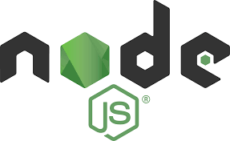
People are using JavaScript for more things than anyone ever wanted to…
Notes:
Front end: React, Angular, etc
Server Side: NodeJS, MongoDB, CouchDB
Desktop Apps: Electron, NW.js

Slide 3
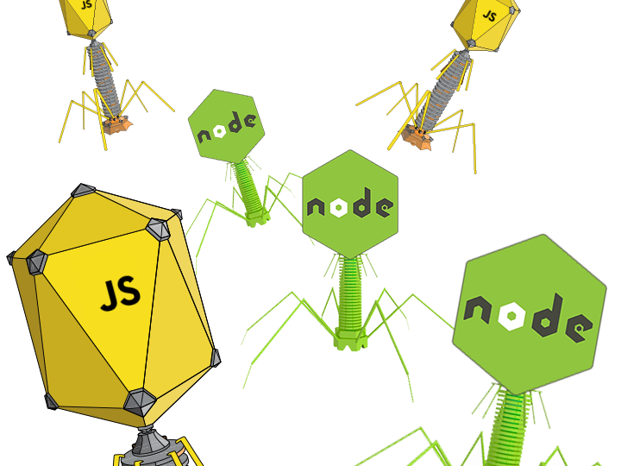
JavaScript is a virus…
… and it CANNOT. BE. STOPPED.
Notes:
* I write a lot of JavaScript.
* It can handle MOST use cases

Slide 4

But it can’t do everything!
And what it’s NOT good at tends to be pretty cool…
Notes:
Mention that JavaScripts concurrency model is not designed for heavily CPU bound tasks:
More on that in a second
Some examples are:
Audio Processing
Media Streaming
Graphics Processing
Heavy Math calculations

Slide 5
Tasks that require little IO but BIG processing power
JavaScript is well suited to I/O bound applications
Example: TODO app
CPU:
Process request
CPU:
Prepare Response to Client
CPU:
Process request
CPU:
Prepare Response to Client
I/O:
Wait for request
I/O:
Make DB call to to insert TODO
I/O:
Send response to client, Wait for next request
I/O:
Make DB call to update TODO
I/O:
Send Response to Client
Notes:
* This is an example of a task that JavaScripts concurrency model is perfect for

Slide 6

Tasks that require little IO but BIG processing power
JavaScript struggles with CPU bound applications
Example: Electron Mustache app
CPU:
Proprietary Mustaching [sic] Algorithm
I/O:
Receive face image
I/O:
Respond with Mustachioed face
Notes:
Here’s another example.
We want to utilize SnapChat’s proprietary Mustaching algorithm in an electron app that streams images of your face and renders an hilarious mustache on top of it.
Lets also pretend that SnapChat’s open sources a C++ implementation of this algorithm!

Slide 7

Notes:
So Why exactly is this a problem?
To understand we need to take a closer look at the event loop
Since we’re talking about an electron app in this case I’ll introduce NodeJS’ event loop implementation
Its called libuv
It has one of the coolest in tech
To be honest this slide is only here to show you how awesome the logo is
And For the record: I don’t know why its called libuv and I don’t know why its logo is a dinosaur unicorn

Slide 8
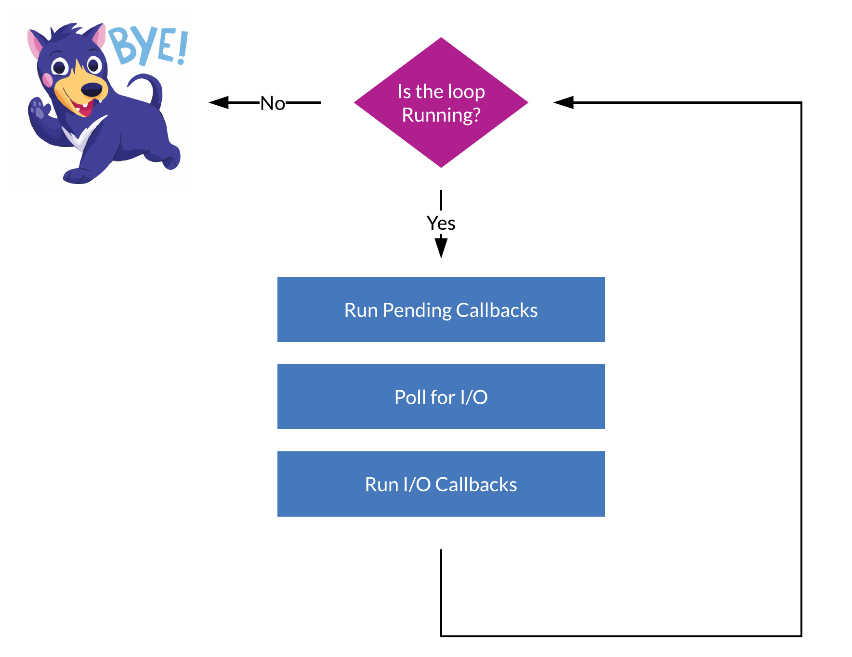
libuv in a Nutshell
(This is a gross simplification)
Notes:
This is a really simplified look at how libuv works, but its enough to understand the problem:
First we check whether or not we need to keep running the loop, if not we quit
Then we run any callbacks that are pending
Then we block for a small amount of time (HOW LONG IRL?) and poll for I/O
Capture inputs
Reading from a file completed
Then we run any of the I/O callbacks that were attached to any I/O requested that have completed
These are your onClick event callback, readfFile callbacks etc
Then we iterate VERY fast (HOW FAST IRL?)
The reason CPU bound tasks cause issues is:
Since we’re single threaded all of our callbacks are synchronous and we need to wait for them finish before continuing
So if you’re waiting around for the CPU in any of these callbacks for too long everything gets held up
In the web this will manifest most obviuosly to the user as poor performance:
Janky UI, slow response to input etc

Slide 9

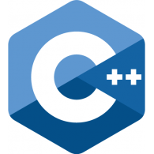
So how do I add mustaches to my electron app?
We can write a native NodeJS addon in C++!
Notes:
So how can we solve this problem and get our mustaches rendered?
NodeJS runs on the same JS engine that runs Google Chrome, and its called V8
V8 is written in C++
Low-level interactions in NodeJS work by binding JS calls to C++ apis
This is what happens when you use fs module
But we can make our own C++ bindings!
This gives is the low-level performance of a C++ as well as the ability to use SnapChat’s C++ algorithm
However by default these will still run in V8s event loop thread, which will block when we render our mustaches
In order to fix that, we need to

Slide 10
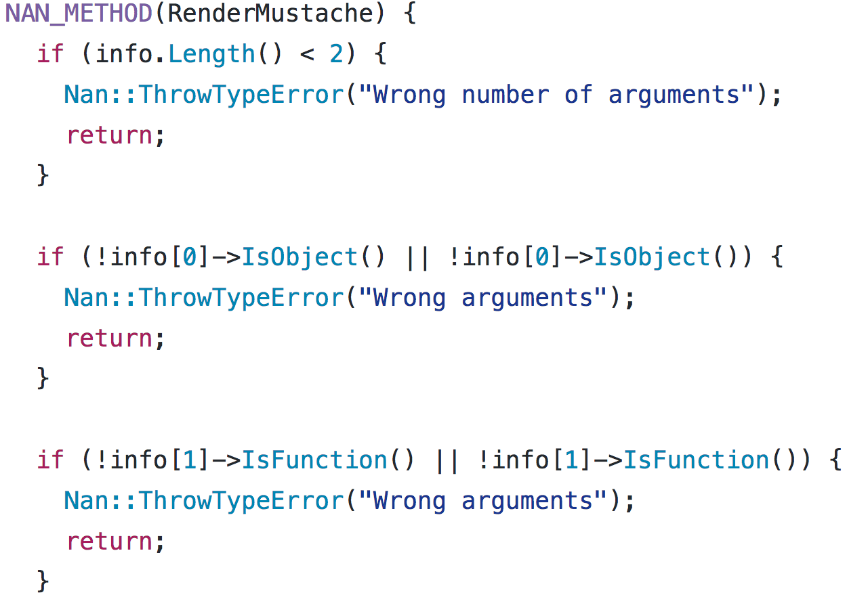
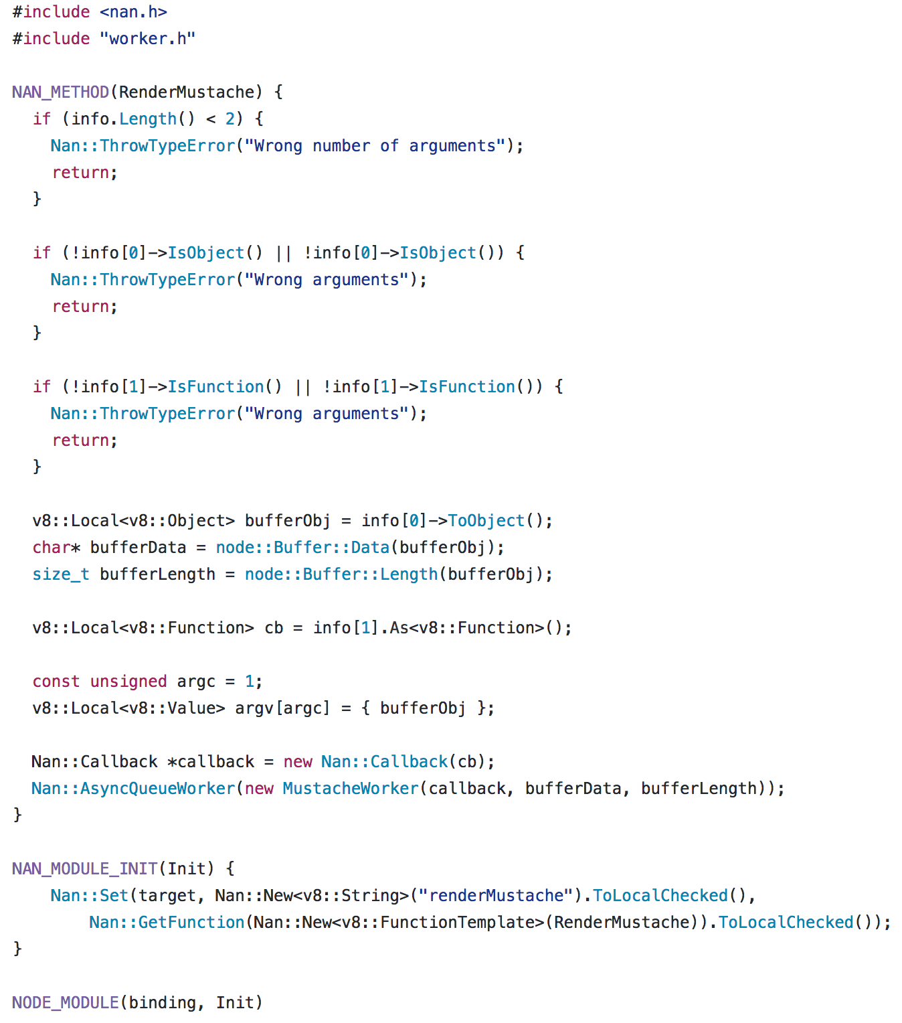
Binding.cpp
Notes:
I apologize if you don’t know C++. Its not the easiest language to follow even when you do it, so try not to focus too much on the syntax
Here where defining our RenderMustache function. This is the function that will be called when someone calls renderMustache in the JavaScript code
Since JavaScript has a dynamic type system and C++ is statically typed we need to make some assertaions about the arguments that were passed inf
In the first if, we check that the # of arguments passed are correct
Then in the second and third if statements are checking that the arguments are the correct type

Slide 11
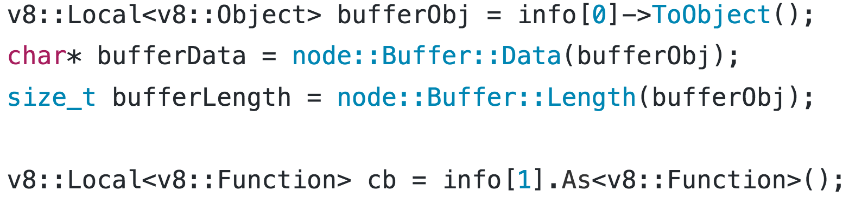
Binding.cpp
Notes:
Now that we know the arguments are as expected we’re going to cast them to types that we can use
We’re casting both arguments to Local Handles can be thought of as pointers to the stack where the contents of a JavaScript variable are stored
So we have a local handle to an object for the first parameter
And a local handle to a function for our second parameter
In this case our first param is a filebuffer representing the image of a face
So we extract the contents of the buffer as a char array
Also the length of the buffer

Slide 12
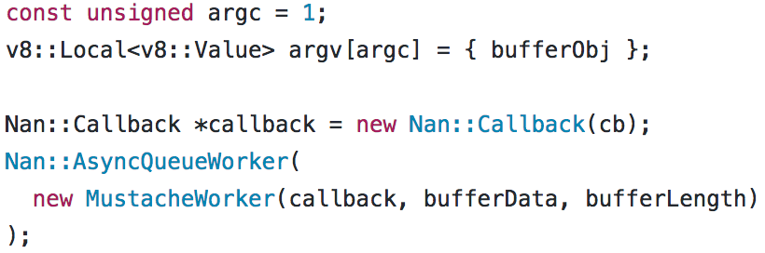
Binding.cpp
Notes:
There’s some confusing syntax here (as there often is when working with v8)
But essentially what we’re doing is creating a new instance of a custom MustacheWorker class that I’ve defined elsewhere and adding it to libuv’s async queue
This is what is actually going to render our mustache on a separate thread, So we’ll take a closer look at the MustacheWorker class in just a second

Slide 13
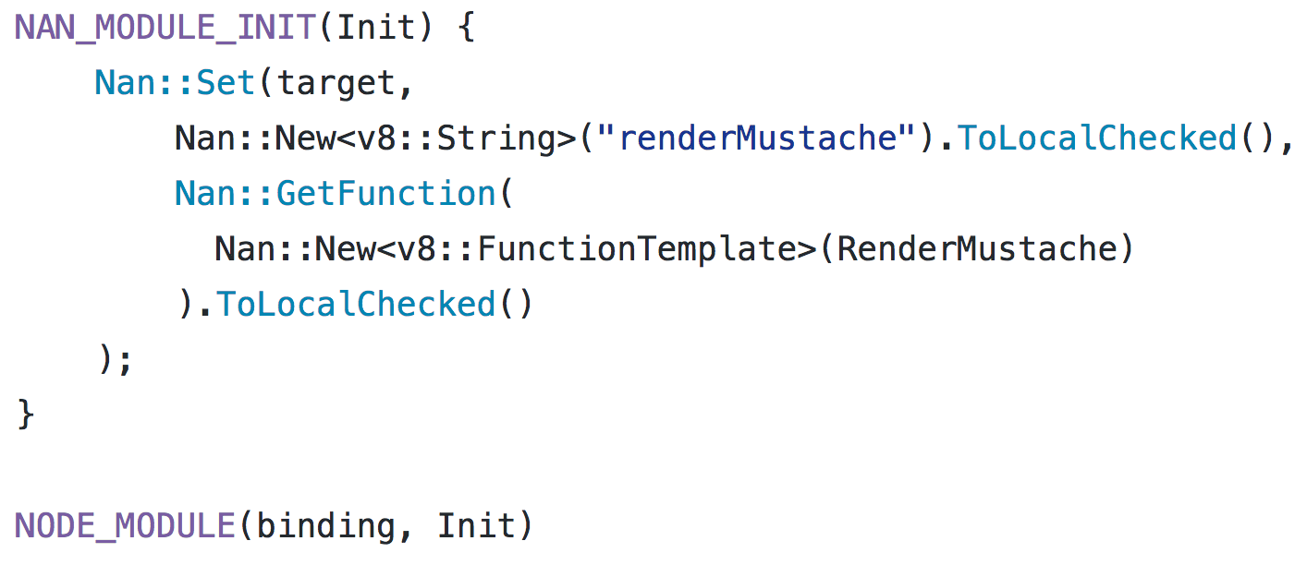
Binding.cpp
Notes:
Outside of our main RenderMustache method theres two more points of interest in the binding file
This NODE_MODULE macro is what actually registers our addon with node at runtime which lets us require it as we would any other JS module
At initialization time it will call this NAN_MODULE_INIT function which assigns a property called “renderMustache” to the module and assigns it to the function we defined above.
This is pretty much the same as assigning the function to module.exports.renderMustache as you would when writing a node module in JavaScript

Slide 14
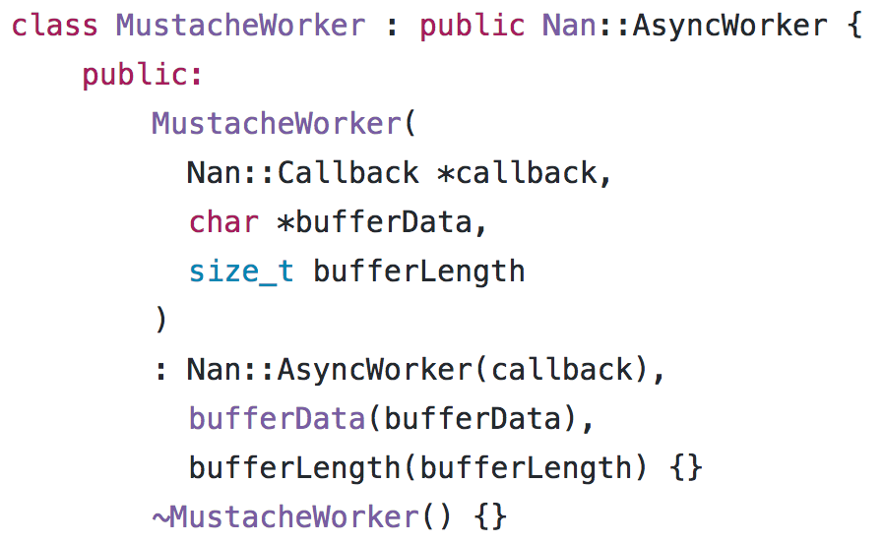
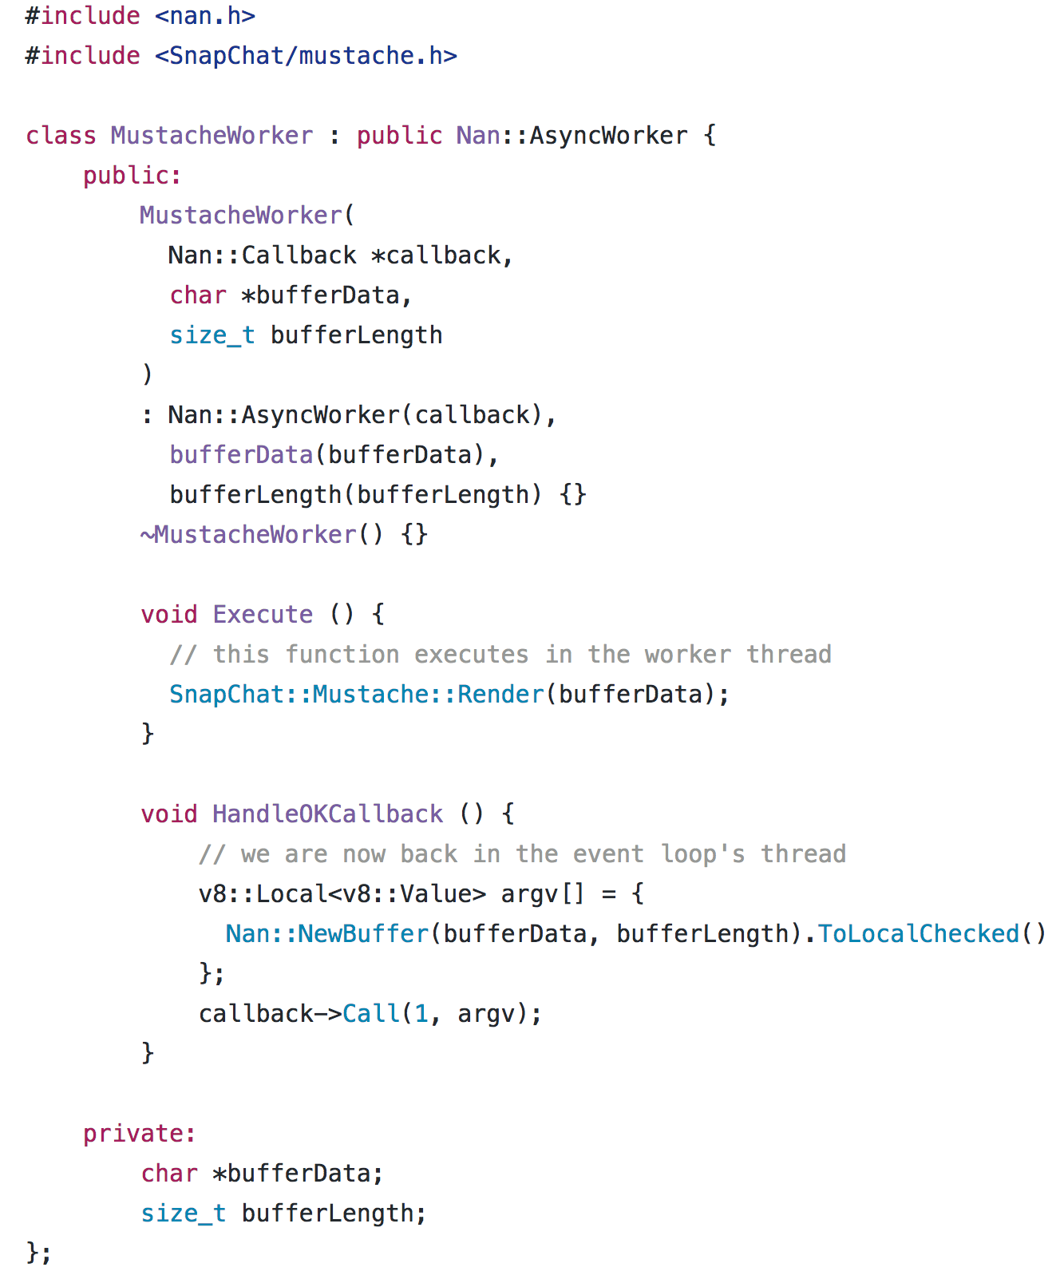
MustacheWorker.cpp
Notes:
As promised, This is our MustacheWorker class:
It extends AsyncWorker which is an abstract class provided by Node to make working with threads easier
As we saw previously, it takes in a pointer to callback, the raw buffer data, and the length of the buffer data
Then we have some fancy C++ syntax that assigns the constructor arugments to private members of the class so we can access them later

Slide 15
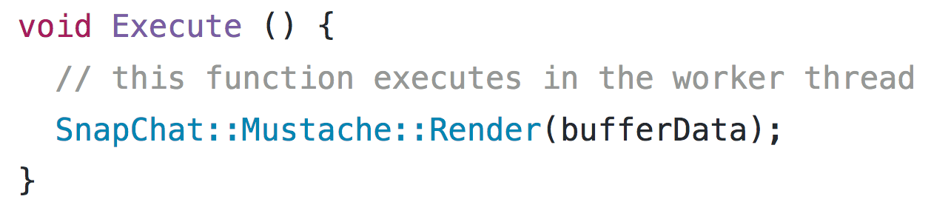
MustacheWorker.cpp
Notes:
Then we implement our Execute function:
This function is what gets run in the worker thread.
Since we’re running in a separate thread now, we can safely take our time without blocking the event loop, so lets render that mustache!
Its worth mentioning that we can only access v8 memory in the event loop thread, so we can’t make any JS callbacks or access JS variables at this point
So we have to just operate on the raw bufferData that we passed in to the constructor

Slide 16
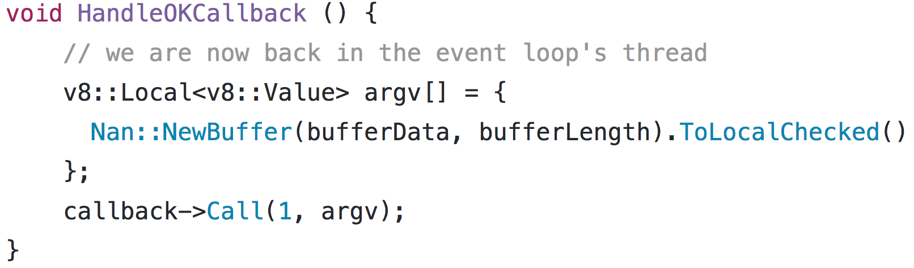
MustacheWorker.cpp
Notes:
The we implement the HandleOKCallback:
This gets called during a tick of the event loop once our Execute function has finished
We are now back in the event loops thread so lets be quick about it!
All we’re going to do here is create a handle to a new NodeJS buffer from our raw file data and call our callback with it

Slide 17
Binding.cpp
Notes:
Now that we know the arguments are as expected we’re going to cast them to types that we can use
We’re casting both arguments to Local Handles can be thought of as pointers to the stack where the contents of a JavaScript variable are stored
So we have a local handle to an object for the first parameter
And a local handle to a function for our second parameter
In this case our first param is a filebuffer representing the image of a face
So we extract the contents of the buffer as a char array
Also the length of the buffer

Slide 18
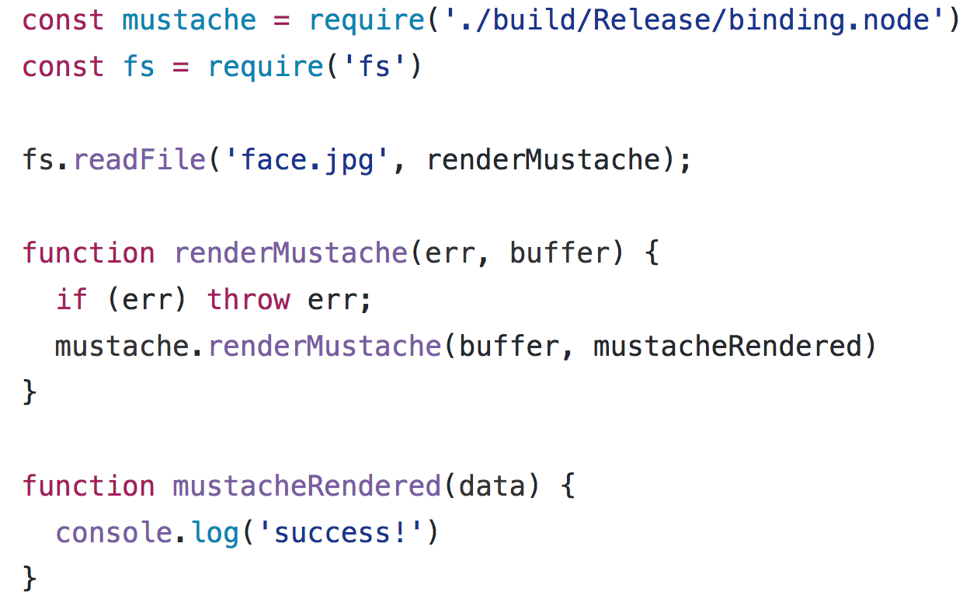
index.js
Notes:
Here’s is an example on how we can use this module in JS
First we require the module as we would any other node module
Then we read in an image file (in this case ‘face.jpg’)
In the callback for readFile we’re going to call the renderMustache function we created and pass in the file buffer and our mustacheRendered callback function
Then once our addon is done rendering the mustache our mustacheRendered function gets called with the resulting filebuffer

Slide 19
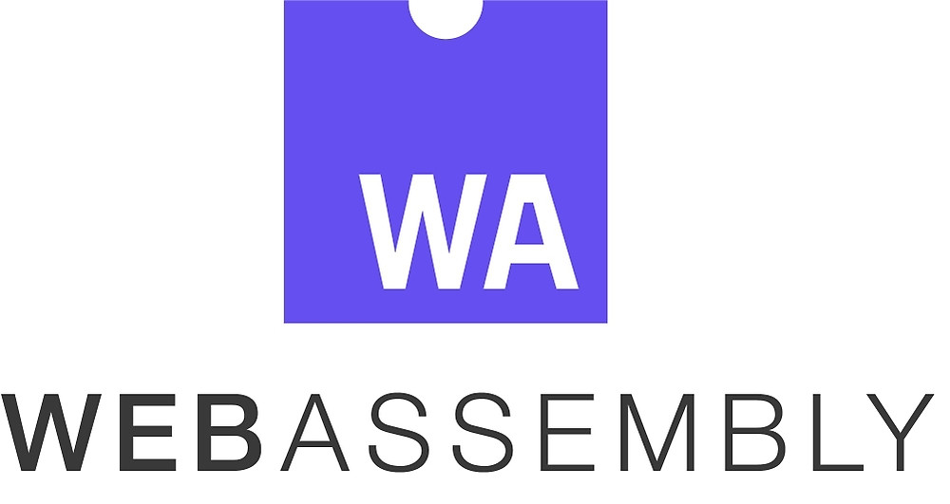
C
C++
Rust
Compiler (LLVM)
JavaScript
ByteCode

Slide 20
What’s the catch?
Browser Sandbox
Virtualization overhead
Tooling is still young
Planned, but not in MVP:
No DOM integration (yet)
Thread Support (yet)
Notes:
WebAssembly is run in a similar sandbox as regular Javascript.
It does not have direct filesystem access, but can access a sandboxed virtual filesystem
WebAssembly runs in a browser which needs to behave the same way across all browsers. When you compile C++ to WebAssembly, its not compiling directly to machinecode as it usually does.
As it stands its still a bit tricky to get tricky to get the toolchain setup in order to compile to WebAssembly and requires compiling LLVM from source. I expect this to get easier as the ecosystem matures.
There is currently no way to reference the DOM from WebAssembly code, but this is listed as future goal of the project
There is currently no way to run WebAssembly code in more than one thread:

Slide 21
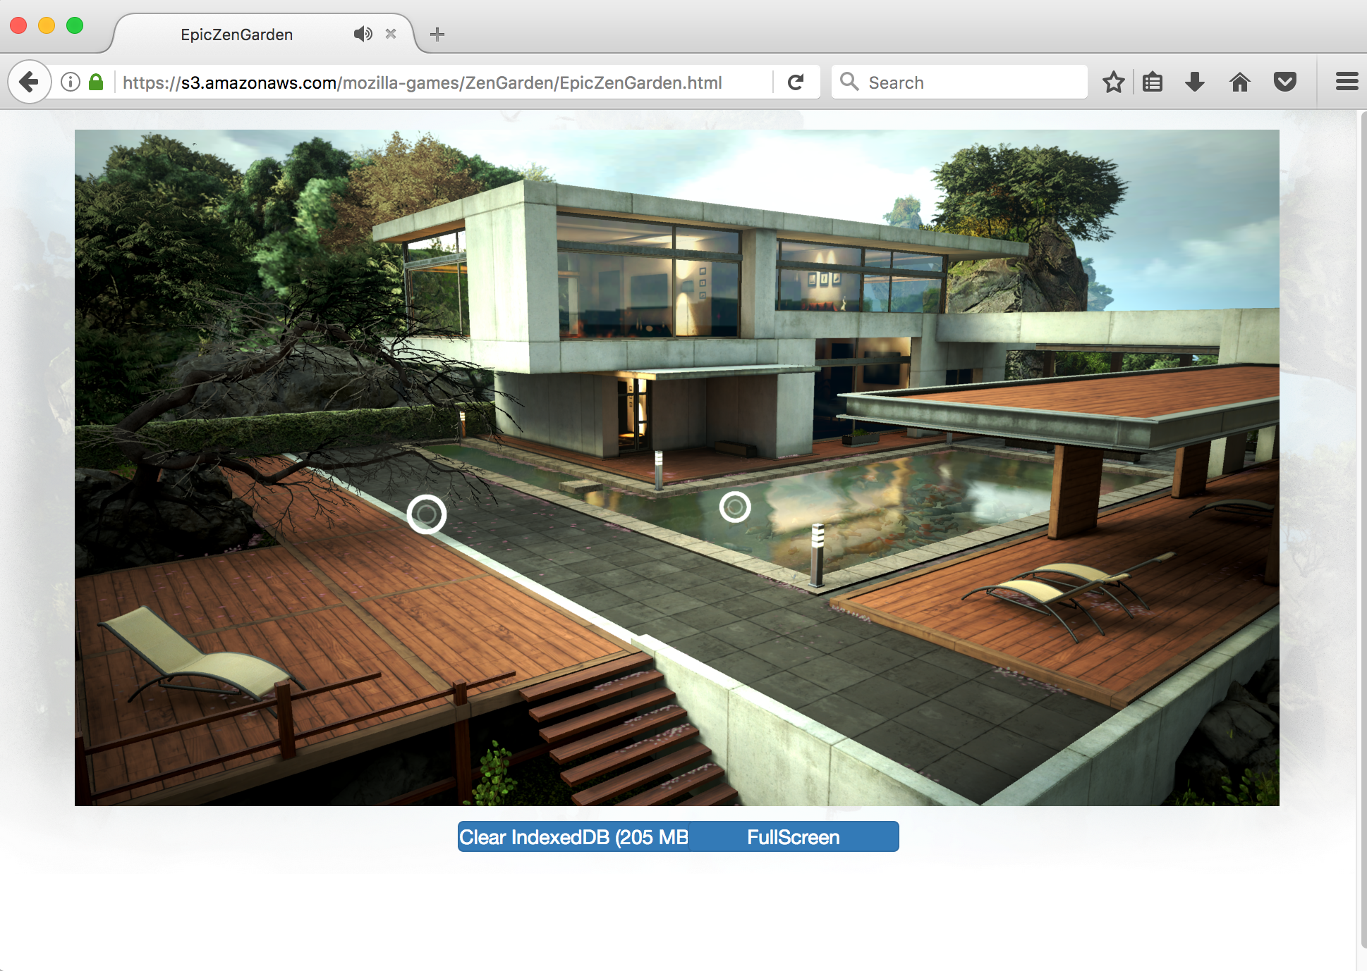
Its pretty cool…
Notes:
This is a screenshot I took myself running a tech demo that epic games put out.
Its using a version of the Unreal 4 engine compiled to WebAssembly
Doesn’t seem to work in Google Chrome

Slide 22
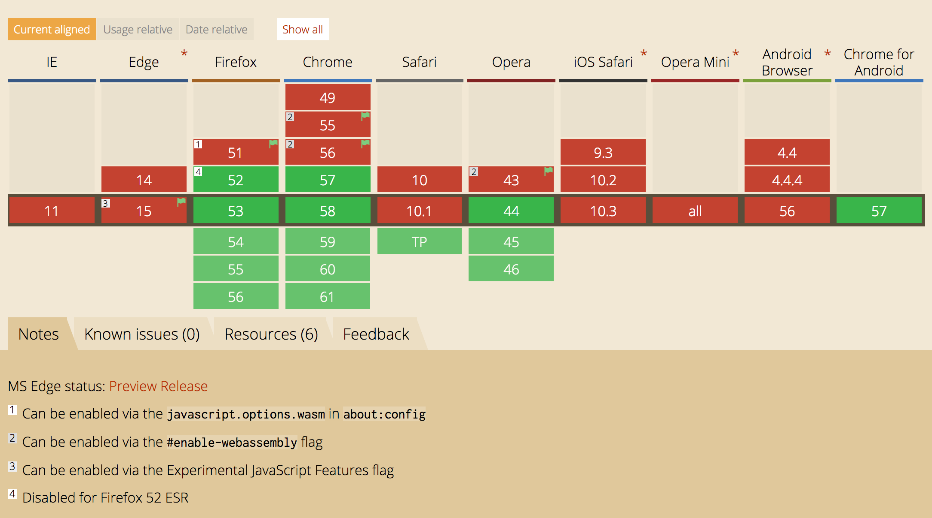
Can I use it yet?
Notes:
Languages that can be built with llvm can be compiled to WebAssembly already:
This includes C/C++, Rust
MVP implementation is available already for FireFox, Chrome, Safari and Opera

Slide 23


Thank You
@daveramirez
/ramirezd42
Notes:
Thanks a lot for listening,
You can reach me on twitter: @daveramirez
If you want to take a look at some of the work of done with node addons you can check feel free to look me up on github. Myusername is ramirezd42

